Slide 1
Welcome Back!
Foundations: Module B
Managing Behavior in Common Areas and With Schoolwide Policies

Slide 2
Session Objectives
Review the improvement cycle and “Kisses of Death”
Analyze how common areas, schoolwide policies, and the factors that contribute to misbehavior
Analyze structural and organizational and variables and design clear expectations
Develop a plan for teaching expectations

Slide 3
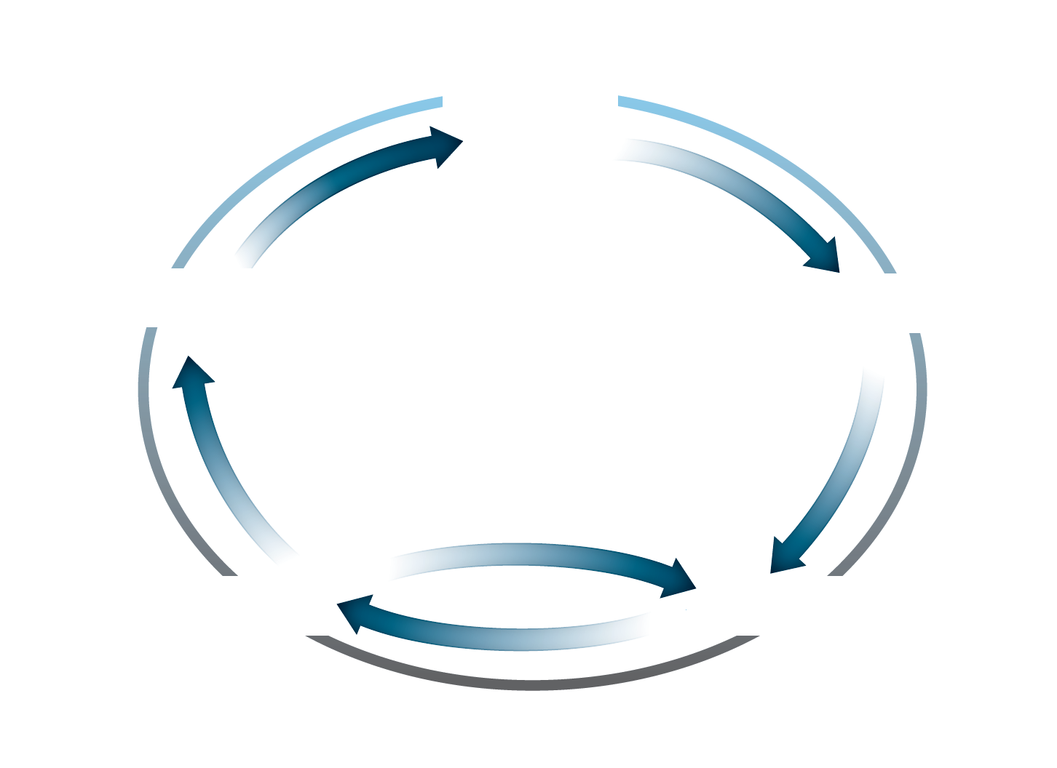
Review: Improvement Cycle

Slide 4
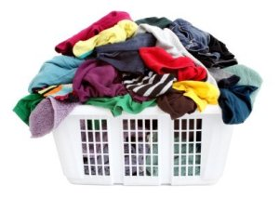
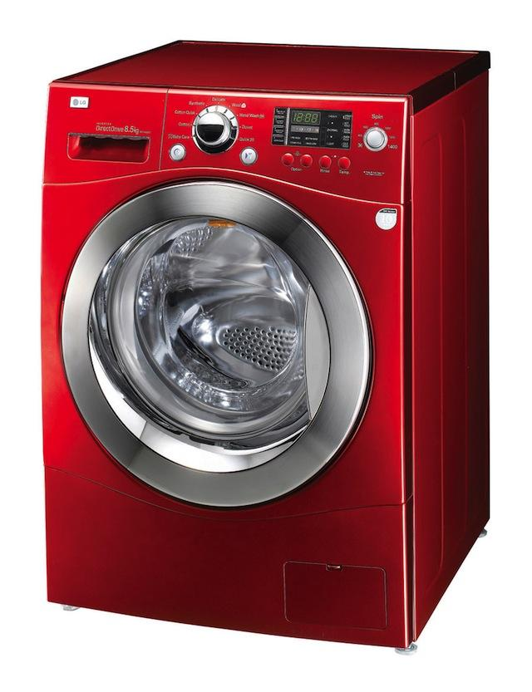
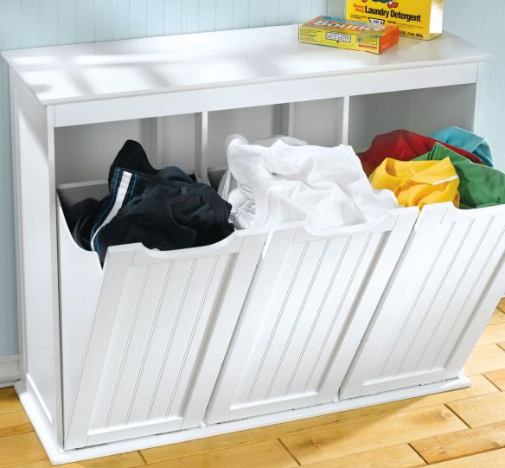
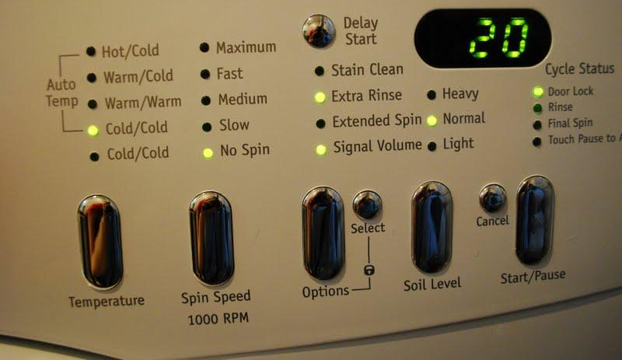
Improvement Cycle

Slide 5
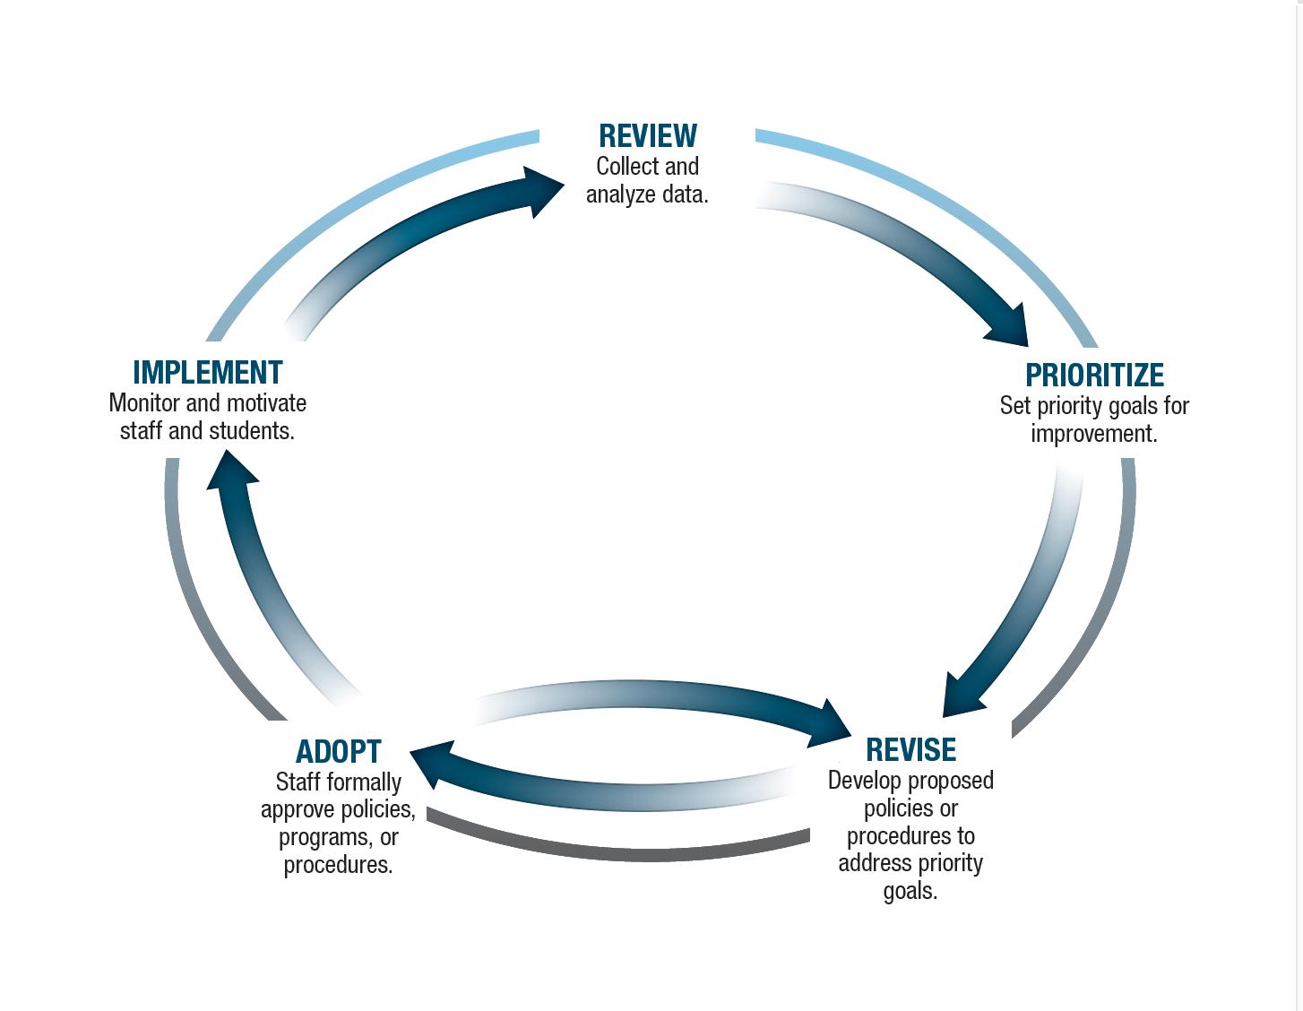
Improvement Cycle…It’s Your Turn

Slide 6
Kisses of Death
Module A, P2, Task 4, pg 70

Slide 7
Homework: From Last Session

Slide 8
Universal Procedures
1-5%
Intensive
10-20%
Targeted
80-90%
Universal

Slide 9
Last Month: Module A
P1, Task 1, pg 7

Slide 10
Module B Overview
P1, Task 1, pg 7

Slide 11
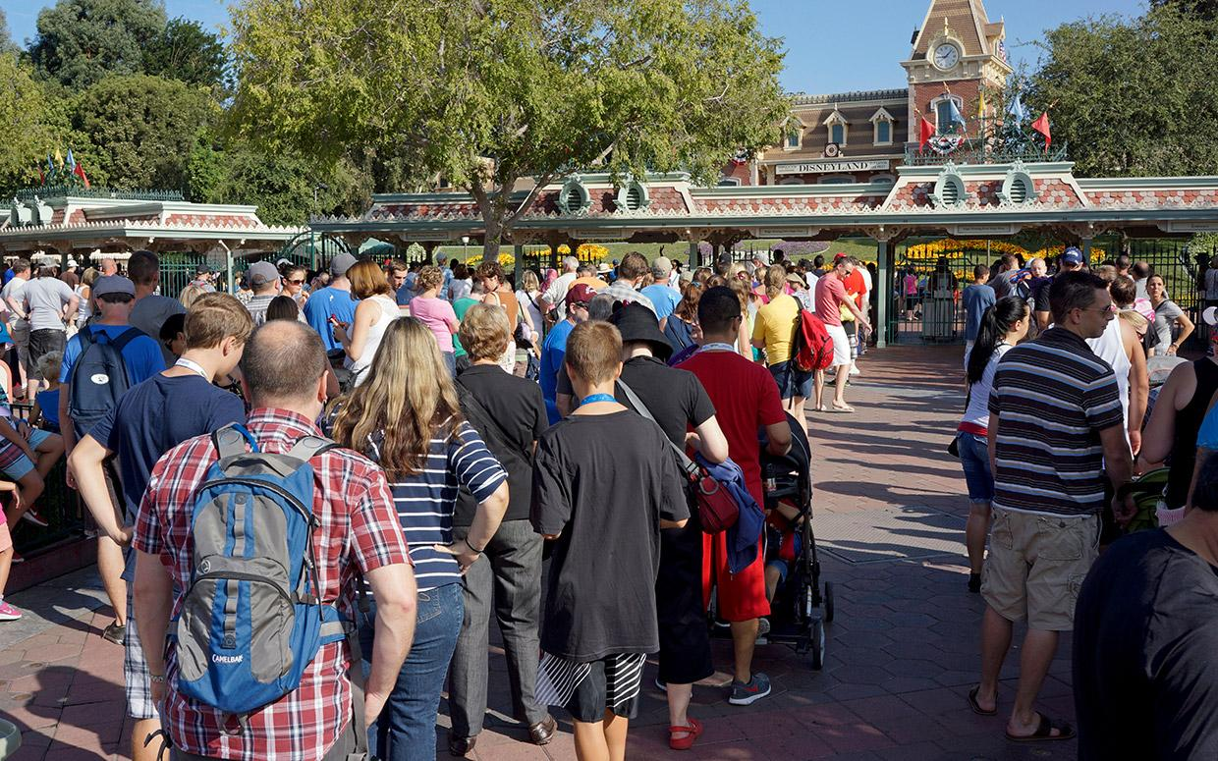
P1, Intro, p.6

Slide 12
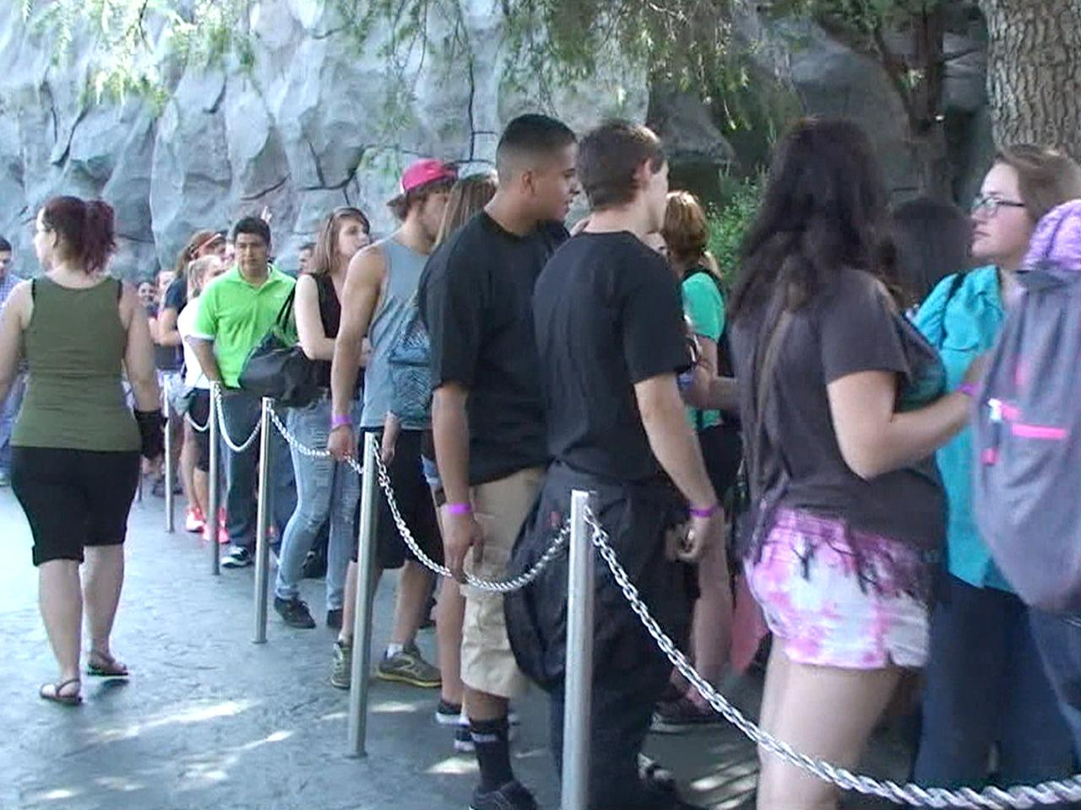

Slide 13
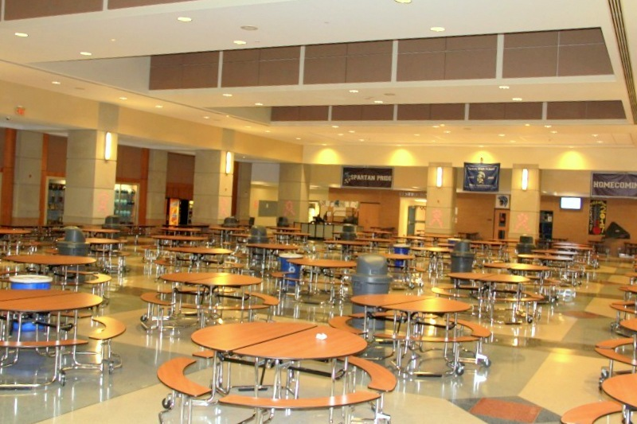
When common areas are safe, civil, and productive and school wide procedures are enforced with clarity and consistency, schools tend to be safe, civil, and productive.
Foundations Module B, p. 6

Slide 14
Understand Common Areas, Schoolwide Procedures, and the Factors That Contribute to Student Misbehavior
Foundations Module B
Presentation 1, Task 1

Slide 15
What are common areas and schoolwide procedures?
P1, Task 1, pg 11
Common Area Locations
Common Area Situations
School Wide Procedures

Slide 16
Five Variables to Consider
Structure
Teach
Observe
Interact positively
Correct fluently

Slide 17
Determine Whether More Information is Needed to Begin Revising the Prioritized Area or Procedures
Foundations Module B,
Presentation 1, Task 2

Slide 18
Revise Step

Slide 19
Design the Steps of Your Revision Process
Foundations
Module B, Presentation 1, Task 3

Slide 21
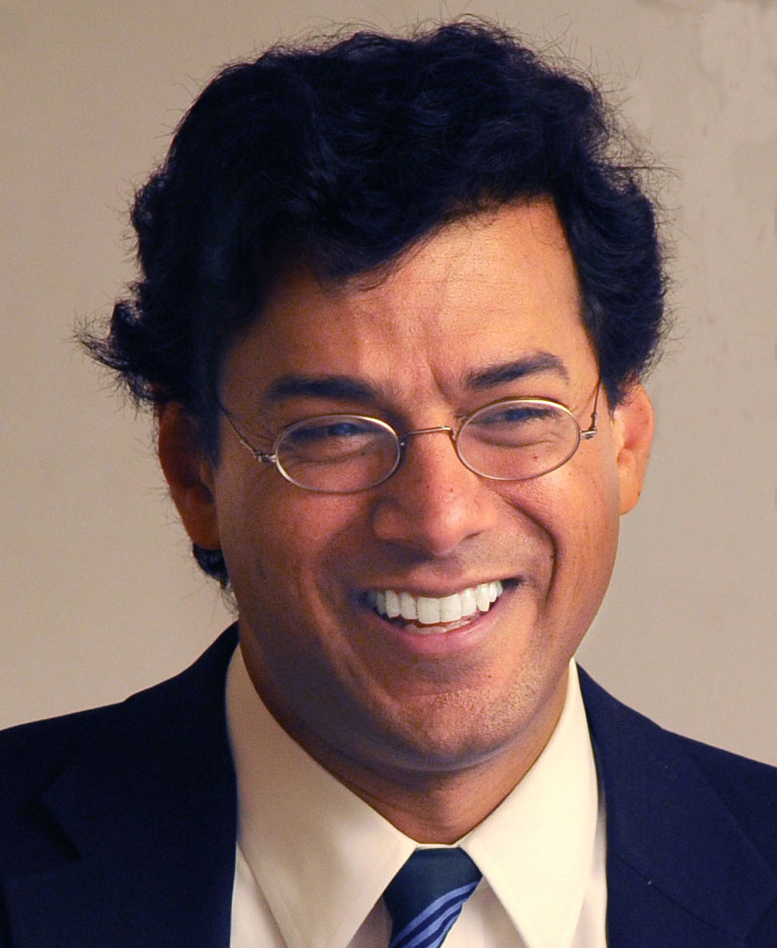
Checklist Manifesto

Slide 22
P1, Task 3, pg 26
Checklists remind us of the minimum necessary steps and make them explicit.
Checklists instill a kind of discipline of higher performance.

Slide 23
Structuring Common Areas and School Wide Policies for Success
Foundations Module B,
Presentation 2

Slide 24
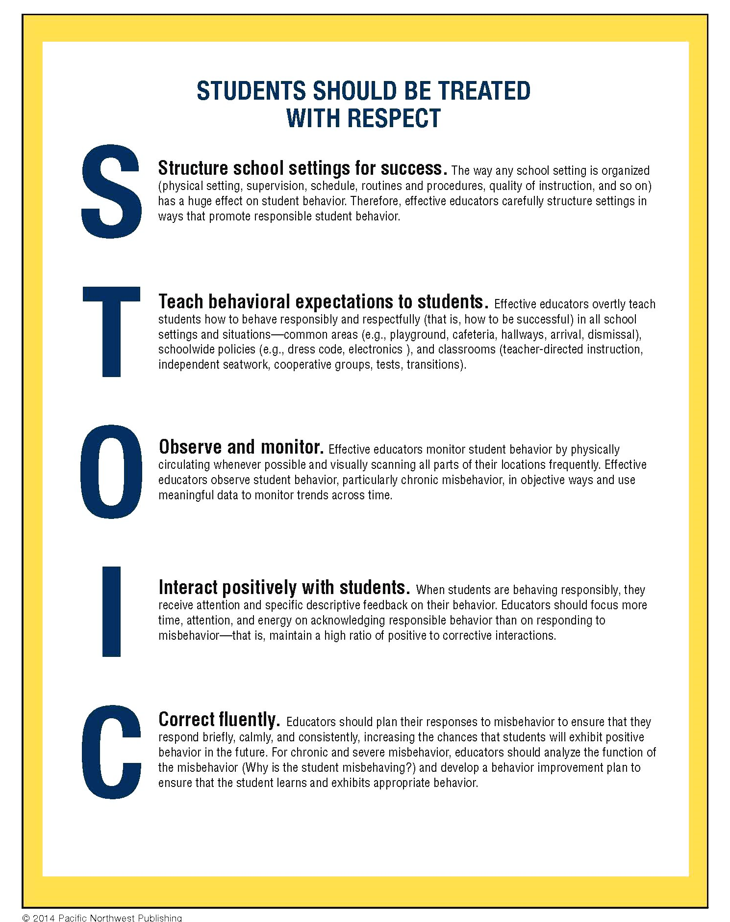

Slide 25
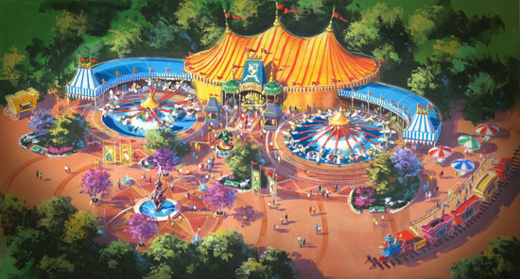
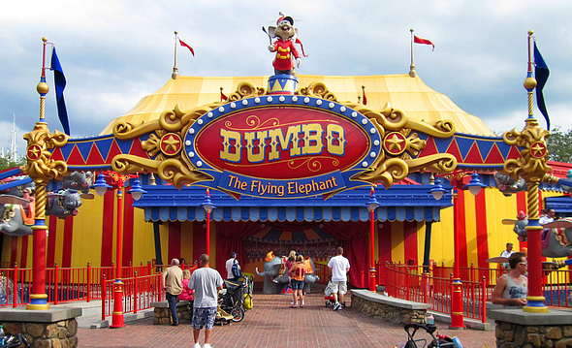
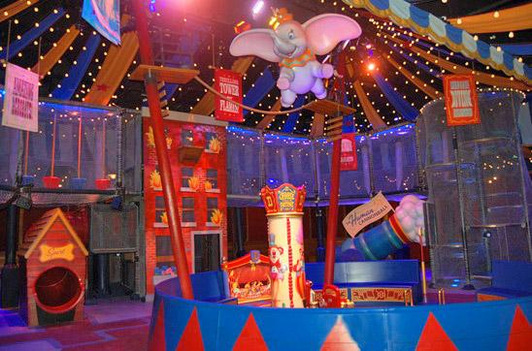
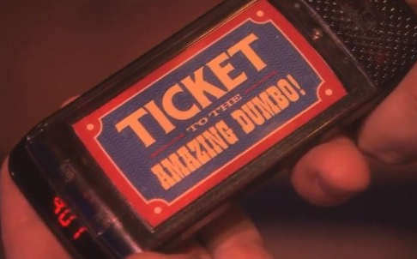
Structural & Organizational Variables

Slide 26
Analyze Physical Setting & Materials

Slide 27
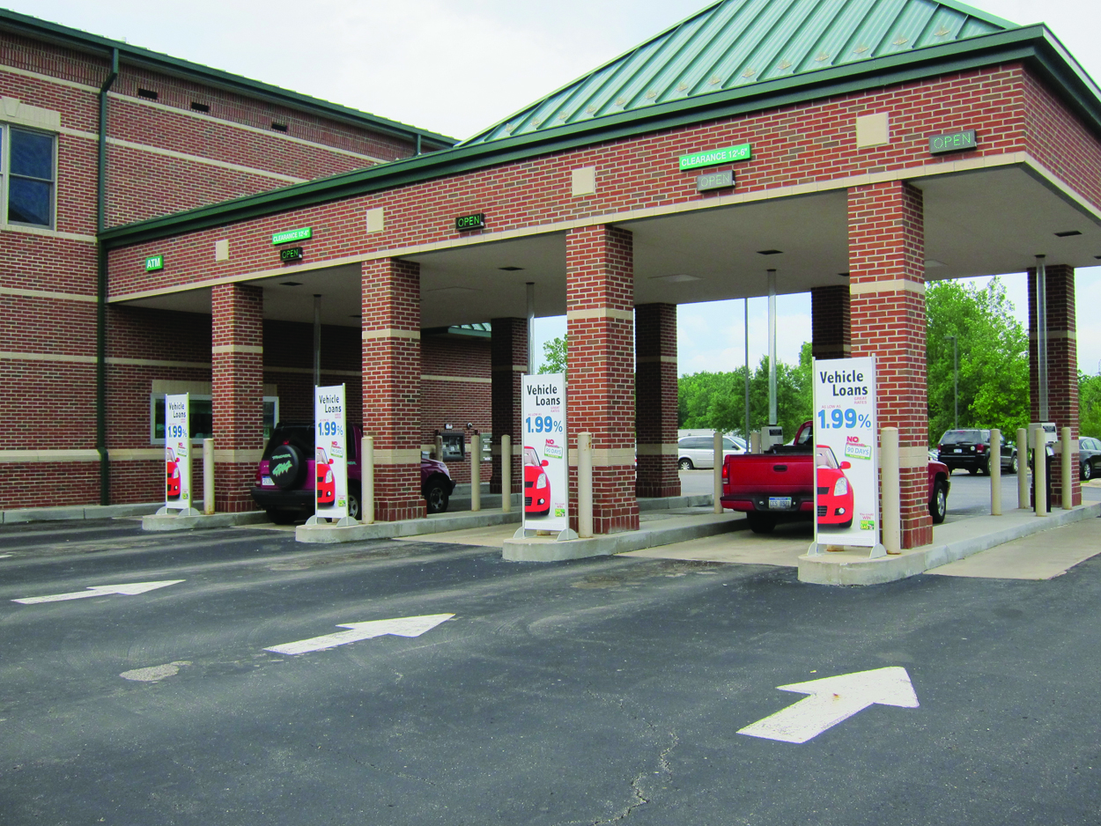
Structural & Organizational Variables
Analyze Entry & Exit Procedures

Slide 28
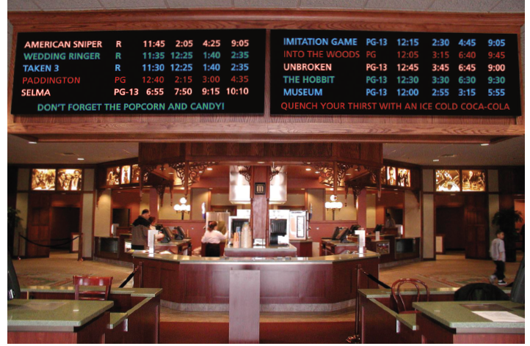
Structural & Organizational Variables
Analyze the Schedule

Slide 29
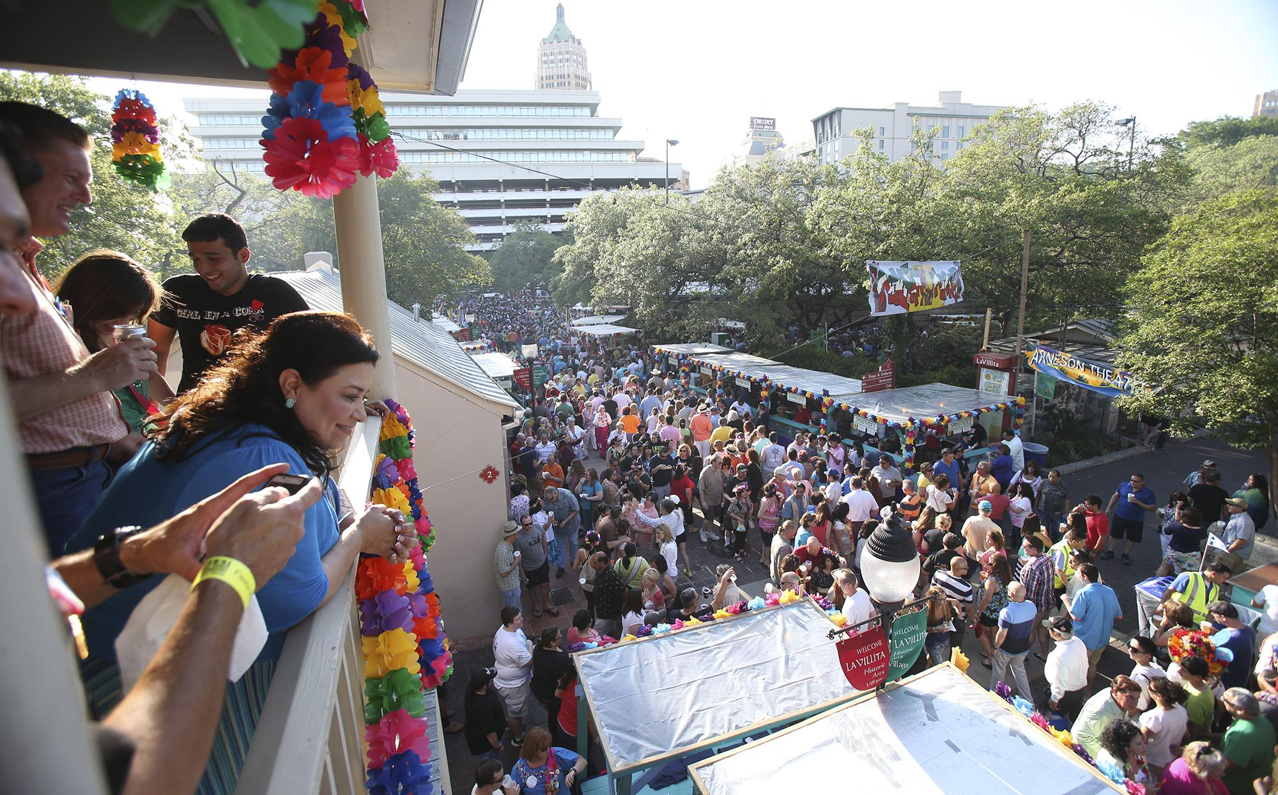
Structural & Organizational Variables
Analyze Concerns about Crowding

Slide 30
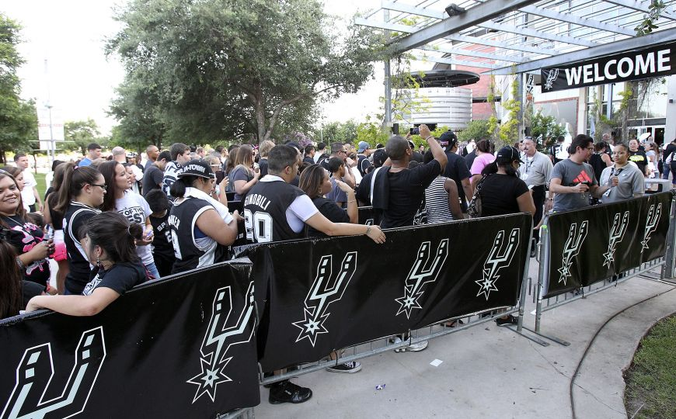
Structural & Organizational Variables
Analyze Procedures

Slide 32
Structure for Success
STOIC

Slide 33
P2, Task 2, pg 48

Slide 34
Effective Common Area Behavioral Expectations:
P2, Task 2, pg 49
DONT FORGET!!!
Clear
Age appropriate
Detailed
Reasonable
Known by all staff members who supervise or may be in the setting or situation

Slide 35
EXPECTATIONS
P2, Task 2, pg 49

Slide 36
Expectations for Adult Behavior
Teachers will be at their doorways at least two out of three passing periods.
Teachers on prep will supervise halls before the period begins and intermittently supervise restrooms.
Security and administrative staff will circulate unpredictably and intermittently.
All staff will interact positively with all students.
All staff will correct misbehavior with quick, one liner reminders.

Slide 37
Task 3: Planning for Adequate Supervision:
P2, Task 3, pg 58
Number of supervisors
Schedule for supervisors
Placement of supervisors
Emergency communication
Comprehensive job descriptions
Supervisor training

Slide 38
Adequate Supervision:
Update & Clarify Expectations
P2, Task 3, pg 58

Slide 39
Be Present
What can adults do to prompt responsible student behavior?
Model appropriate behavior.
Provide positive feedback.
Monitor more carefully.
Encourage students who do not interact.
STOIC

Slide 40
Ensure Adequate Supervision
Refer to pages 58-71
Evaluate the current supervision arrangements for each common area improvement priority.
Brainstorm suggestions for any aspects of the supervision arrangements that need improving.
Develop job descriptions for supervisors of particularly complex settings, such as playgrounds and cafeteria.

Slide 41
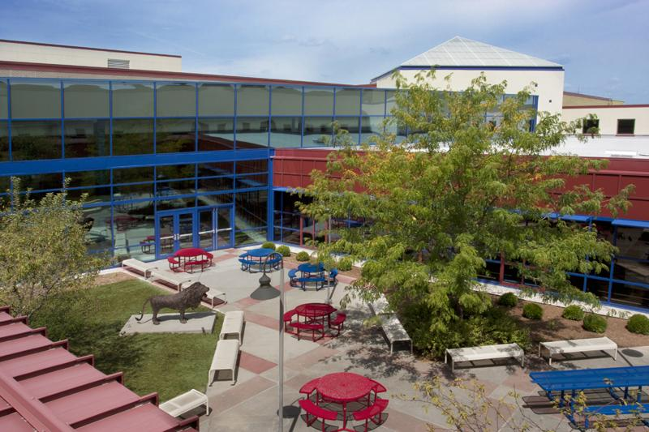
Teaching Expectations to Students Module B, Presentation 3
Students can’t be expected
to intuitively know how to behave: they need to be taught how to function in those
specific settings and situations.

Slide 43
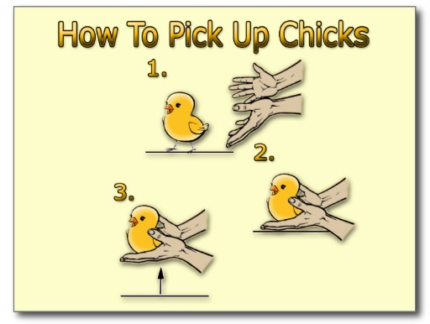

Slide 45
Organize to Ensure Expectations Are Taught
Foundations Module B Presentation 3, Task 1

Slide 46
Planning for Teaching Expectations
P3, Task 1, pg 76
Sample Schedule for Teaching Cafeteria Lessons
Topic | Day 1 | Day 2 | Day 3
Entering | X
Waiting in line | X | X
Noise level | X | X
Making menu choices |  | X
Treating adults with respect |  | X | X
Clean up | X | X | X
Recycling |  | X | X

Slide 47
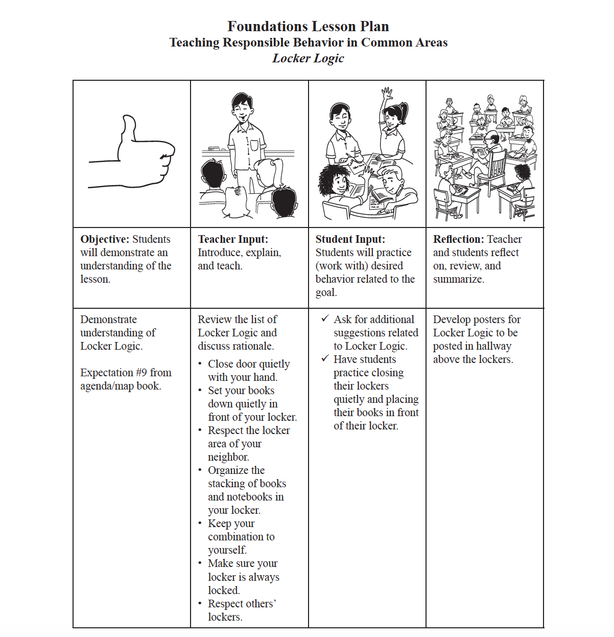
P3, Task 1, pg 83

Slide 48
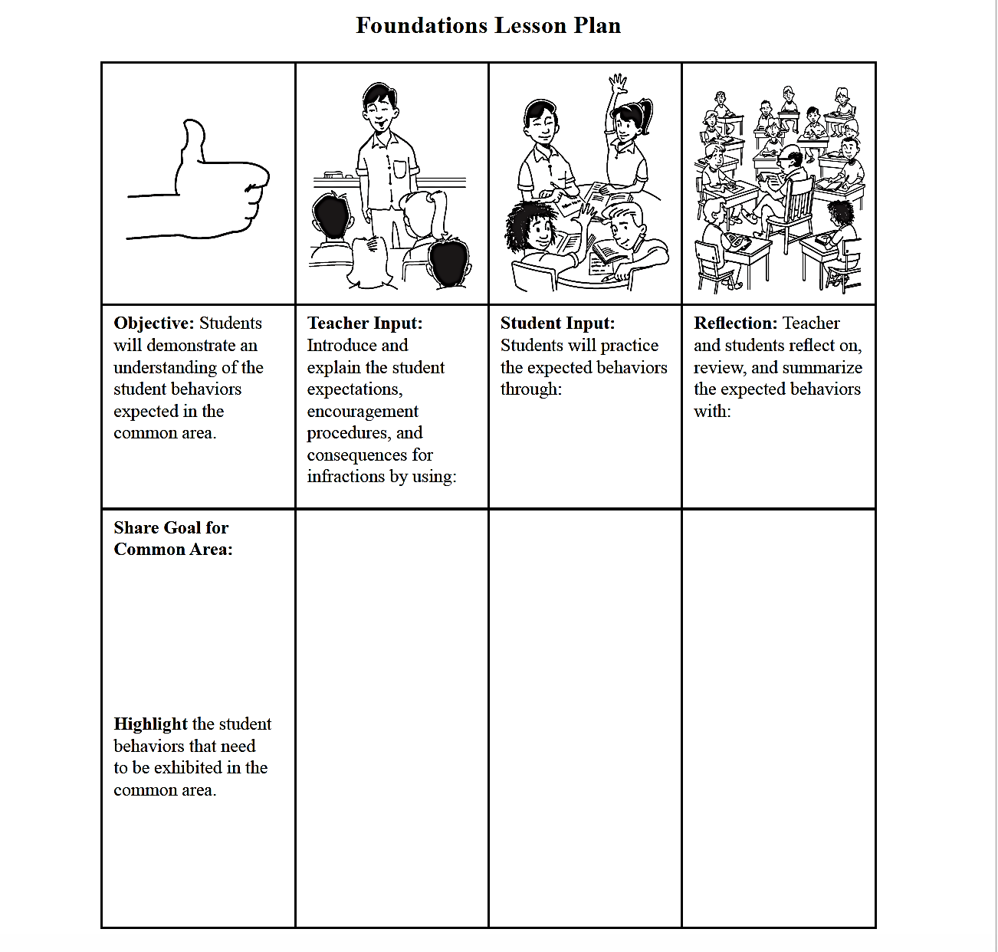
Table Task
P3, Task 1, pg 82

Slide 49
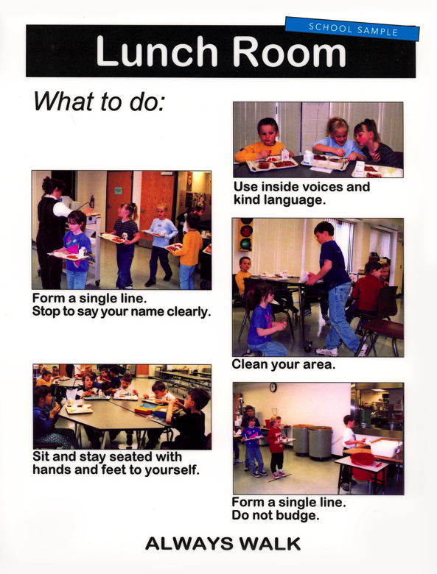
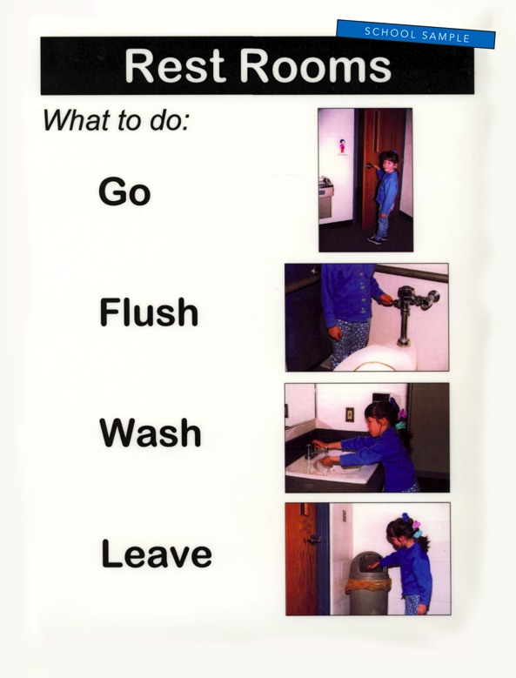
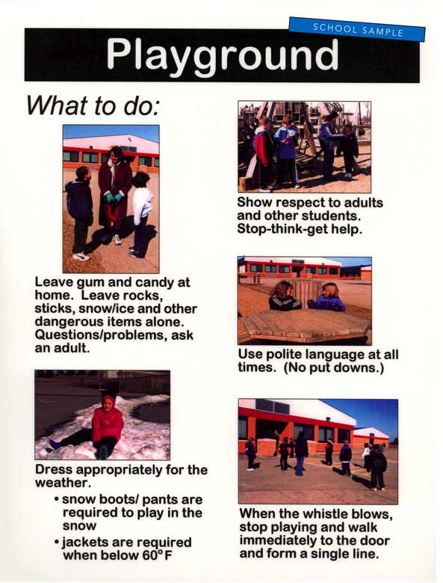
Posters Teaching Expectations
P3, Task 1, pg 79
Prairie Heights Elementary School in Cedar Rapids, Iowa

Slide 50
P3, Task 1, pg 78
Excerpts from the
How to Respond
to Reminders
PowerPoint
Fulton Elementary School, San Diego, California

Slide 51
Planning for Teaching Expectations
Flush video from the DVD
Rogers MS

Slide 52
STOIC
Structure for success.
Teach expectations with clarity.
Observe and supervise.
Interact positively.
Correct fluently.

Slide 53
Teach and Launch Expectations for Multiple Common Areas and School Wide Policies
Foundations Module B,
Presentation 3, Task 2

Slide 54
Teach and Launch Expectations

Slide 55
P3, Task 2, pg 90

Slide 56
3-2-1 Summary

Slide 57
Teach and Launch New Expectations

Slide 58
Expectations: Plan for Re-Teaching

Slide 59
Expectations: Plan for Re-Teaching

Slide 60
Universal Procedures
1-5%
Intensive
10-20%
Targeted
80-90%
Universal

Slide 61
Your Homework

