Slide 1
WHAT IS “FOUNDATIONS?”

Slide 2
GROUP NORMS
Limit side conversations
Ask for help anytime
Take care of your personal needs
Prepare to discuss, reflect and plan
Be respectful of one another, keep an open mind

Slide 3
OBJECTIVES
Introduce teams to Foundations materials
Refine our team process
Define the Improvement Cycle
Determine our data collection process
Determine what information to share with staff

Slide 4
MODULE A OVERVIEW
Foundations is modular:
Six major components (or modules)
Modules, Presentations, Tasks
Go directly to relevant content
Foundations is multimedia:
Written materials
Video presentations
Electronic files

Slide 5
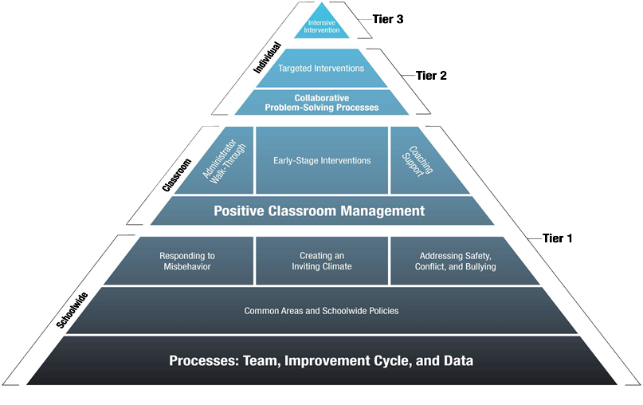
Module A, P1, Page 7
FOUNDATIONS: Creating & Sustaining
a Continuum of Behavior Support

Slide 6
Universal Procedures
1-5%
Intensive
10-15%
Targeted
80-90%
Universal

Slide 7
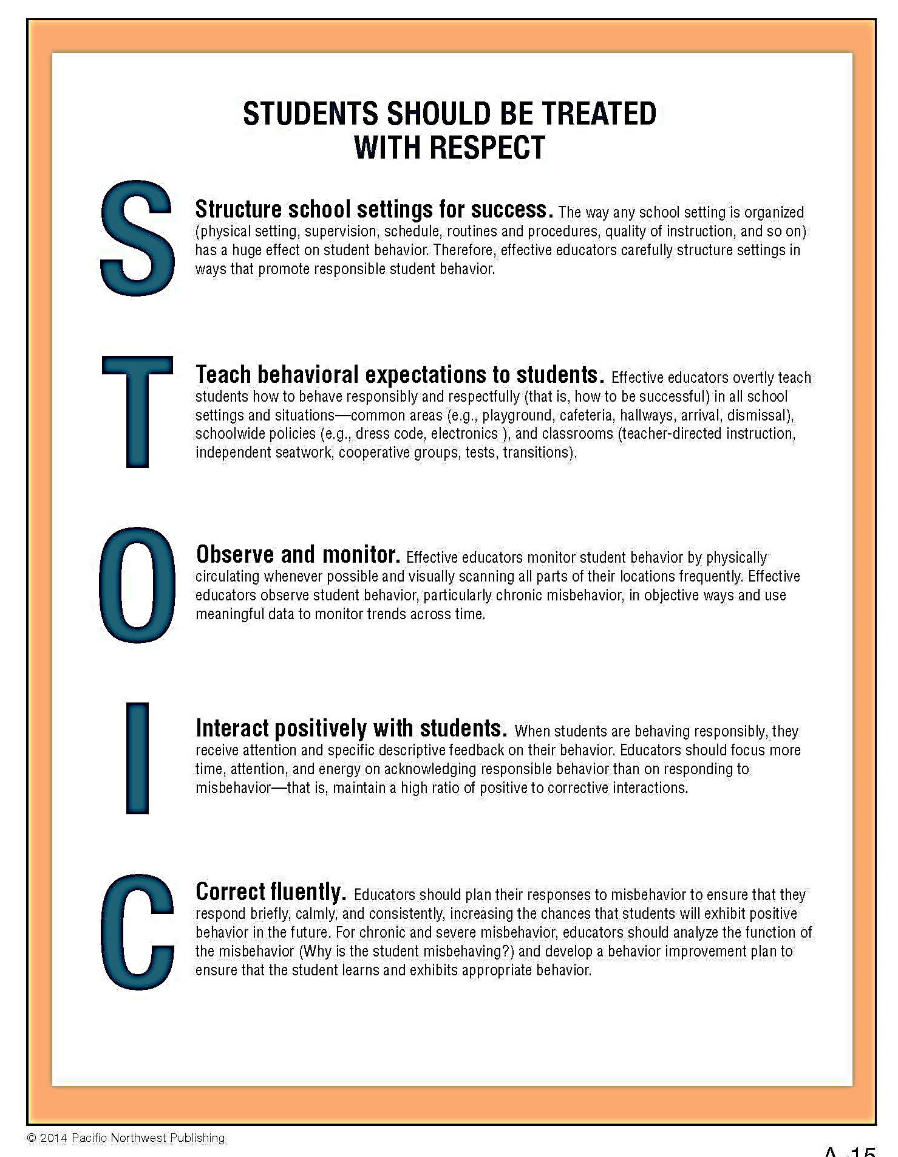

Slide 8
Module A, P1, Task 2, Page 19
Structure
Teach
Observe
Interact positively
Correct fluently

Slide 10
ROADBLOCKS
Module A, P1, Page 23-26

Slide 12
TAKE A LOOK AROUND
Now that your team is formed, the team will work through:
The Improvement Cycle
The use of data
How to involve the entire staff
Begin to work on common areas and schoolwide considerations.

Slide 13
Which is the best approach for your campus? For your kids?
Cautious Approach
Ambitious Approach

Slide 14
MODULE A, PRESENTATION 2
Team Processes

Slide 15
The Team….
WILL
Maintain the Improvement Cycle
Guide and Maintain the School Culture
WILL NEVER
Develop final procedures or policies

Slide 16
YOUR TASKS
1. Assemble the Foundations Team
2. Actively Engage the Staff
Choose a team name
Summarize the purpose of the team
Be highly visible

Slide 17
TEAM ROLE
The team will:
Save the staff time.
Improve consistency.
Improve student behavior and motivation.
Make everyone’s job more pleasant.
Improve the sense of unity, collegiality, and efficacy.

Slide 18
YOUR TASK
18

Slide 19
ADMINISTRATOR’S ROLE
Ensure the team follows all legal and ethical obligations
Separate mandates from the team
Finalizing decisions if the staff is unable to reach consensus
Holding staff accountable for implemented policies and procedures

Slide 20
TEAM MEMBER TEAMS
Module A, P2, Task 1, Page 43
Administrator is permanent.
Limited terms of approximately 2 years (create stability) but no longer than 3 years (increase staff participation)
Allow some overlap.
Each staff group selects its next representative.
Orient new team members.

Slide 21
TEAM VISIBILITY
Make the team highly visible:
Present at a staff meeting at least once a month.
Issue a newsletter.
Distribute memos.
Seek information from staff (surveys, polls).
Use your team name and branding efforts.
E-Mail

Slide 22
TEAM ROLES
Module A, P2, Task 3, Page 54
Identify team roles and responsibilities.
Chairperson (possibly co-chairs)
Recorder
Data/Evaluation Coordinator
Materials Manager
Keeper of the List
Staff Liaison
Equity and Student Liaison
Family Engagement Coordinator

Slide 23
ANOTHER CONSIDERATION
MTSS Coordinator
Someone who actively thinks about the link between your universal Foundations procedures and the children who need Tier 2 targeted support or Tier 3 intensive support
Creates a seamless link between Tiers 1, 2, and 3
Team Coach or a partner school

Slide 24
YOUR TASK

Slide 25
Team Meeting Schedule
Module A, P2, Task 3, Page 56
Develop and adhere to a regular team meeting schedule.
Meet often enough and long enough to get things done.

Slide 26
TEAM MEETING SCHEDULE OPTIONS:
Weekly for 30 minutes (during first year)
Twice a month for an hour (during first year)
Once a month for a half day (once process is established)
Full day once a quarter (very experienced teams)

Slide 27
YOUR TASK
27

Slide 28
Module A, Presentation 2, Task 4 Sustaining Culture

Slide 29
(Form A-04 on the CD)

Slide 31
Four Corners
Corner 1: Explain it with my eyes closed
Corner 2: I can tell you a little bit about it
Corner 3: I’ve heard of that
Corner 4: Say What??

Slide 32
YOUR TASK
32

Slide 33
Improvement Cycle
Module A, Presentation 3, Page 74

Slide 34
REVIEW
Module A, P3, Task 1, Page 77

Slide 35
PRIORITIZE
Module A, P3, Task 1, Page 77

Slide 36
REVISE
Module A, P3, Task 1, Page 77

Slide 37
Turn & Talk
Have you ever had a time when you started something and the results didn’t happen as easily or quickly as you thought they would?
What could you have done to get the results you wanted?

Slide 38
REVISE
Use the STOIC acronym:
Structure
Teach
Observe
Interact positively
Correct fluently
The STOIC framework is a way to ensure the development of comprehensive revisions.

Slide 39
ADOPT
Module A, P3, Task 1, Page 77

Slide 40
ADOPT

Slide 41
ADOPT: Thumbs Up
Thumb up = I fully support this proposal.
Thumb sideways = I partially support the proposal, but I’m willing to implement.
Thumb down = I cannot support the proposal.

Slide 42
ADOPT: Thumbs Up/Thumbs Down
Anyone voting thumbs-down has to agree to help find an alternative.
The proposal is rejected if even one person votes thumb-down.

Slide 43
IMPLEMENT
Module A, P3, Task 1, Page 77

Slide 45
YOUR TASK
45

Slide 46
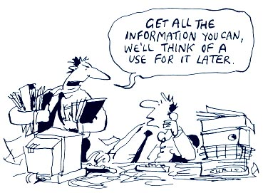
DATA-DRIVEN PROCESSES Module A, Presentation 4

Slide 47
DATA DRIVEN PROCESS
Data help schools avoid ineffective decision making based on:
Subjective feelings
Instinct or overreaction to a single piece of information
Custom or tradition
Power/influence/politics

Slide 48
DATA DRIVEN PROCESS
Available sources of data:
Surveys (perception data)
Observations of common areas
Incident referrals
Existing school records

Slide 49
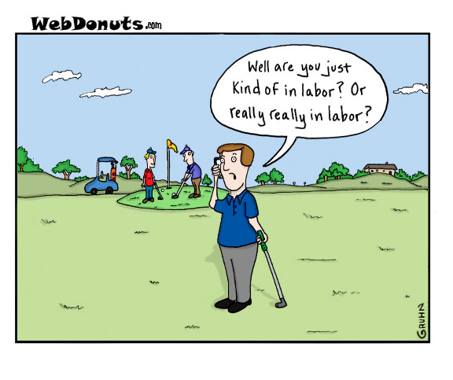
Use Multiple Data Sources to Identify Improvement Priorities
picture

Slide 50
SELECT PRIORITIES
Safety concerns should always be top priorities.
Select a priority most likely to motivate staff.

Slide 51
Data Sources

Slide 52
Task List
Module A, P4, Task 2, Page 126
Task 1: Use multiple Data Sources to Identify Improvement Priorities.
Task 2: Use Survey Data (Perception Data) to Make Decisions

Slide 53
YOUR TASK

Slide 54
TASK LIST
Module A, P4, Task 3, Page 140
Task 1: Use multiple Data Sources to Identify Improvement Priorities.
Task 2: Use Survey Data (Perception Data) to Make Decisions
Task 3: Use Common Area Observation Data to Make Decisions

Slide 55
COMMON AREA OBSERVATION DATA
Module A, P4, Task 3, Page 143

Slide 56
Task List
Module A, P4, Task 4, Page 152
Task 1: Use multiple Data Sources to Identify Improvement Priorities.
Task 2: Use Survey Data (Perception Data) to Make Decisions
Task 3: Use Common Area Observation Data to Make Decisions
Task 4: Use Incident Referral Data to Make Decisions

Slide 57
INCIDENT REFERRAL DATA
Initial decisions:
Are your behavior referral forms completed effectively and objectively?
Do you need to review how your behavioral data management system is working for your campus?
Do you need to review how to share this behavioral data on an ongoing basis with staff?

Slide 58
YOUR TASK
58

Slide 59
Task List
Module A, P4, Task 5, Page 164
Task 1: Use multiple Data Sources to Identify Improvement Priorities.
Task 2: Use Survey Data (Perception Data) to Make Decisions
Task 3: Use Common Area Observation Data to Make Decisions
Task 4: Use Incident Referral Data to Make Decisions
Task 5: Use Other Existing Sources to Make Decisions

Slide 60
Universal Procedures
1-5%
Intensive
10-15%
Targeted
80-90%
Universal

Slide 61
Other Data Sources
Attendance
Nurse referrals/ Injuries
Counselor
Staff feedback
Parent concerns

Slide 62
TASK 5 ACTION STEPS
Design a plan to collect and analyze data on the 90% Thresholds.
Design and implement a plan for using information from other existing data sources:
What sources are available?
Who will be responsible?
Confidentiality
How will data be reported to staff?

Slide 63
Your task: Homework

Slide 64
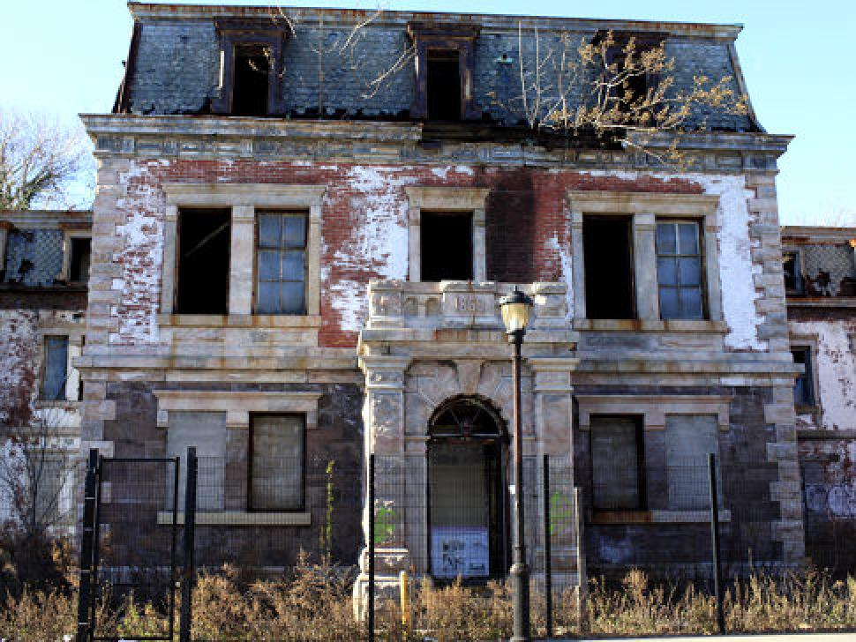

Slide 65
Project Lead Contact Info:
Kara Hallenberger- Program Coordinator, Behavior Support Programs
khalle@neisd.net
Stephanie Heinchon- Director of School Improvement
sheinc@neisd.net

Slide 66
Foundations Collaborative
Work Session
Monday, November 30, 2015
8:00-10:00
10:30-12:30
1:00-3:00
3:30-5:30
RAMEC 619
Choose one session
Sign Up in Eduphoria

