Slide 1
WELCOME BACK!
FOUNDATIONS: MODULE B PART 2
Managing Behavior in Common Areas and With Schoolwide Procedures
Notes:
1
1

Slide 2
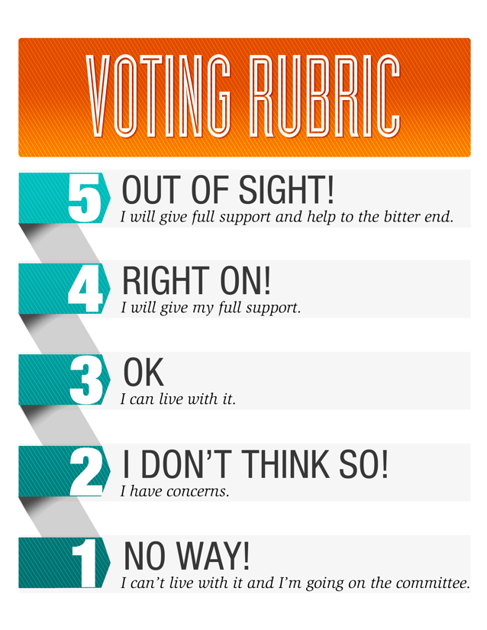
GROUP NORMS
What’s Your Vote?
Limit side conversations
Ask for help anytime
Take care of your personal needs
Prepare to discuss, reflect
Be respectful of one another, keep an open mind

Slide 3
SESSION OBJECTIVES
REVIEW THE IMPROVEMENT CYCLE AND STOIC
CREATE A PLAN FOR TEACHING STUDENT AND SUPERVISORY EXPECTATIONS
HOW TO OBSERVE, INTERACT POSITIVELY AND CORRECT FLUENTLY
CREATE A LESSON PLAN FOR YOUR COMMON AREA
Notes:
3
3

Slide 4
P1, Task 1, pg 7
Module B OVERVIEW
Common Areas & Schoolwide Policies

Slide 5
DO YOU KNOW WHAT THIS MEANS?
80-90%

Slide 6
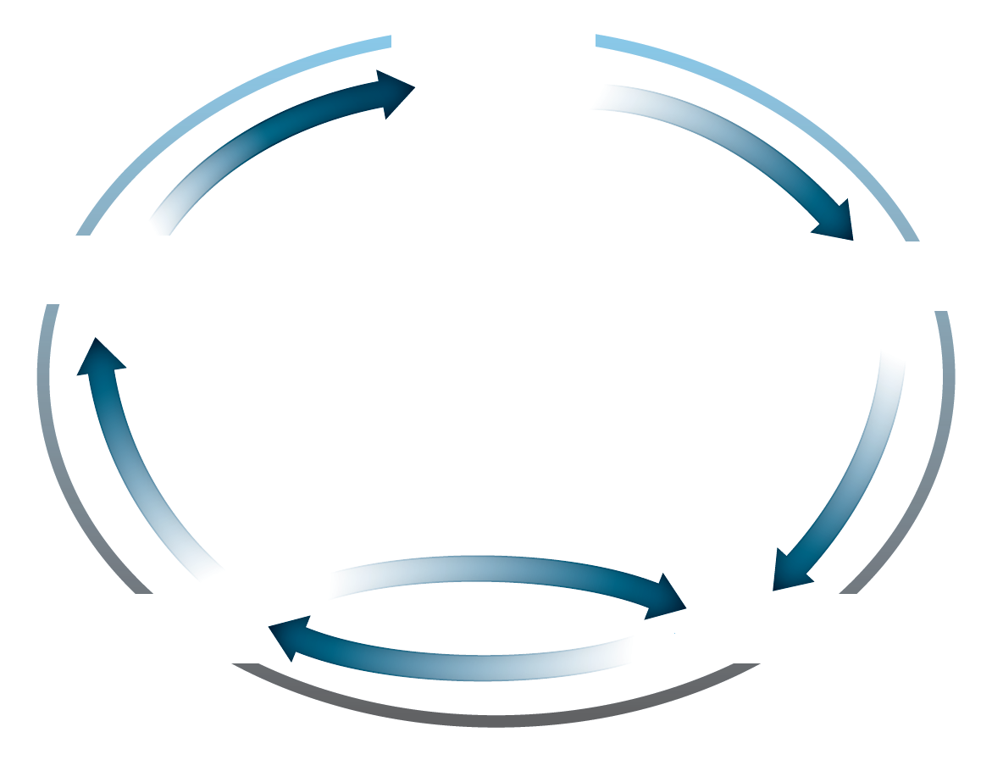
Review: Improvement Cycle

Slide 7
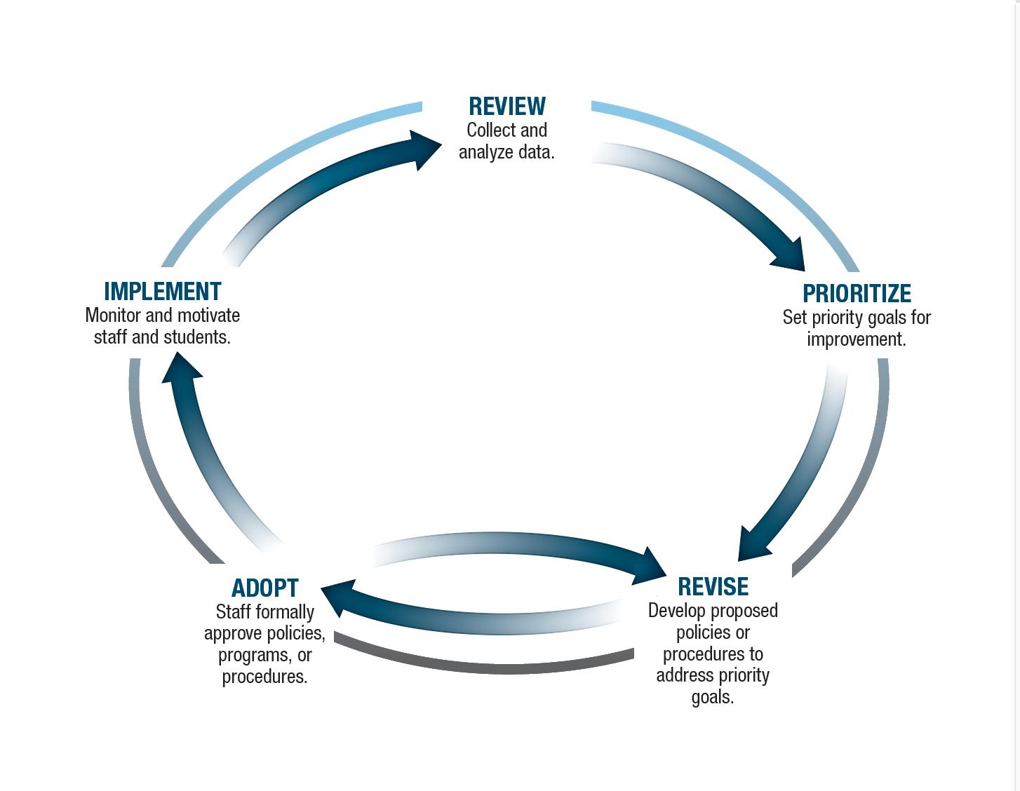
The correct answer is…..

Slide 8
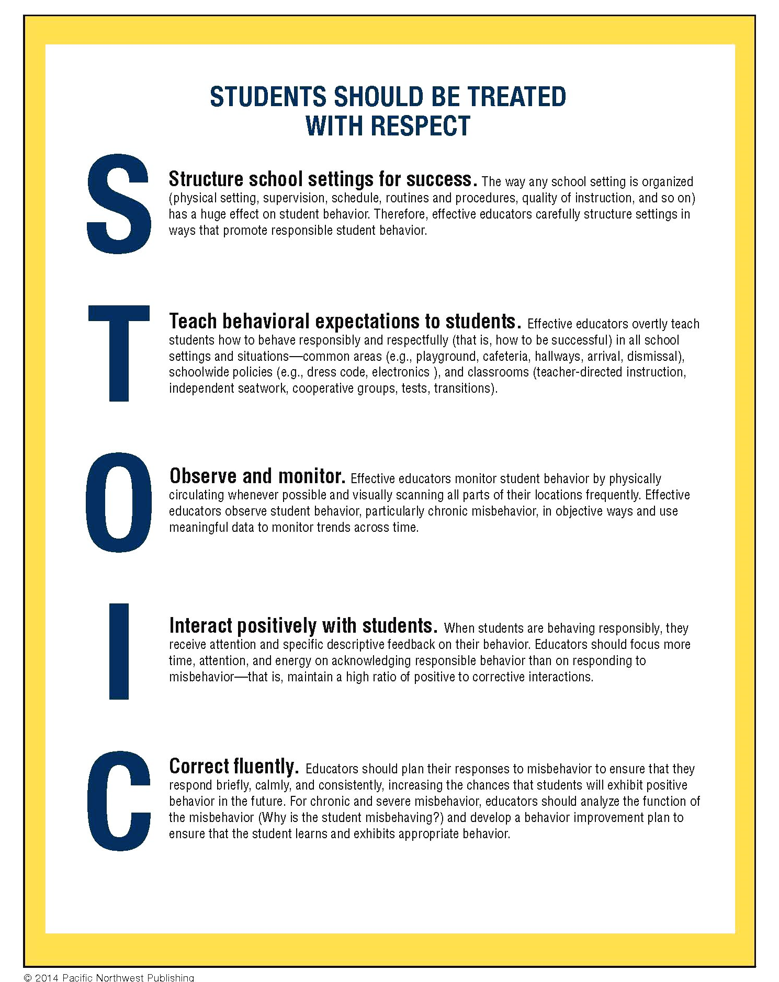

Slide 9
HOMEWORK: FROM LAST SESSION
Notes:
9
9

Slide 10
FOUR CORNERSTONES
TRAINER
SUPPORT
ACCOUNTABILITY
PRACTITIONER

Slide 11
ORGANIZING YOUR BINDER
May keep an electronic version in a shared drive as well
Five Sections:
Works in Progress
Archived- must have data to show it’s working before moving it into the data
Staff Handbook
Student and Parent Addendum
Training Plan- back to school launch, as well as what you do when you retrain in January

Slide 12
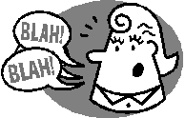
FOR STUDENTS AND STAFF

Slide 13
STUDENT EXPECTATIONS

Slide 14
LET’S PLAN AHEAD

Slide 15
Effective Supervision: For Use With Paraprofessionals
Foundations Module B Presentation 4 and 5

Slide 17
SUPERVISING COMMON AREAS AND SCHOOLWIDE PROCEDURES—FOR ALL STAFF
Foundations Module B,
Presentation 6

Slide 18
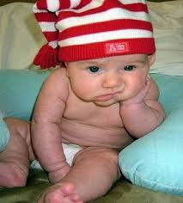
WHAT DID YOU NOTICE?

Slide 19
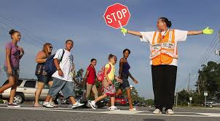
BE PRESENT AND ENGAGED

Slide 20
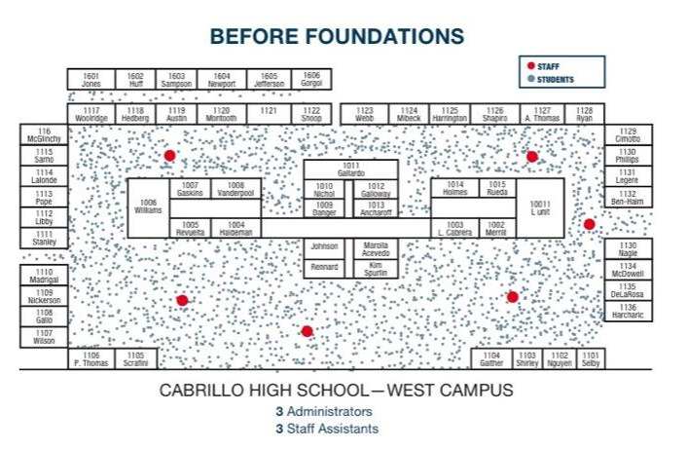

Slide 21
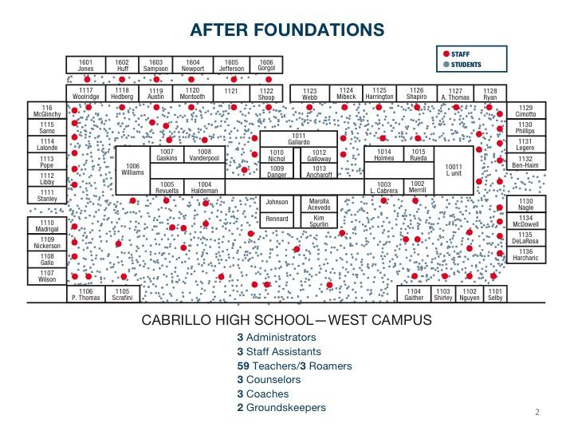

Slide 23
Task 2: Interact Positively
3:1 Ratio of Interaction
+ interaction = you respond when engaged in a positive behavior – a behavior you want to see more of.
- interaction = you respond to a student after they have engaged in an inappropriate behavior – something you do not want repeated.

Slide 24
School climate is not set by the color of the walls, the number of windows or the size of the gymnasium– it is created by the actions and personalities of the adults and how they interact and connect with the students.

Slide 25
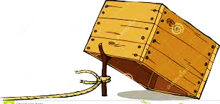
The Criticism Trap
Notes:
Dr. Wes Becker, 1971- wrote about studies that he had conducted with teachers who were reprimanding and reminding students about out-of-seat behavior during work periods. He encouraged the teacher to reprimand students more immediately and more consistently. The teacher assumed this would decrease the behavior. In fact, the number of students getting out of their seats at the wrong time increased.
Why do you think this was?
Dr. Becker called this the criticism trap. Although the teachers thought they were doing something effective, the students, who were starved for attention, were getting out of their seats at least in part to get their teachers to look at them and talk to them.
Have you had those students who have acted out just to receive the negative attention? Some students crave any sort of attention they don’t care if it is negative or positive, so it’s super important to be sure that you are giving the positive feedback.
The only way out of the criticism trap is to have more interactions with the students when they are behaving responsibly than when they are misbehaving.
*At this point, complete number 6 on your STOIC worksheet- Define the rules and procedures for all staff when they are supervising common areas and implementing schoolwide policies.

Slide 26
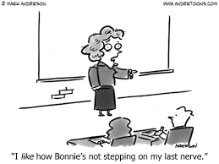
Positive or Negative/Corrective Interactions

Slide 27
Task 3: Correcting Misbehavior Fluently
Briefly
Consistently
Calmly
Respectfully

Slide 28
Responses to Misbehavior
Use the mildest correction or response that reasonably fits the misbehavior.
Gradually increase the severity level.

Slide 29
Menu of Consequences
Proximity Management
Gentle Verbal Reminders and Reprimands
Change in Location
Time Out/Time Away
Referral to a more Intensive Consequence

Slide 30
WHAT’S YOUR ONE-LINER?

Slide 31
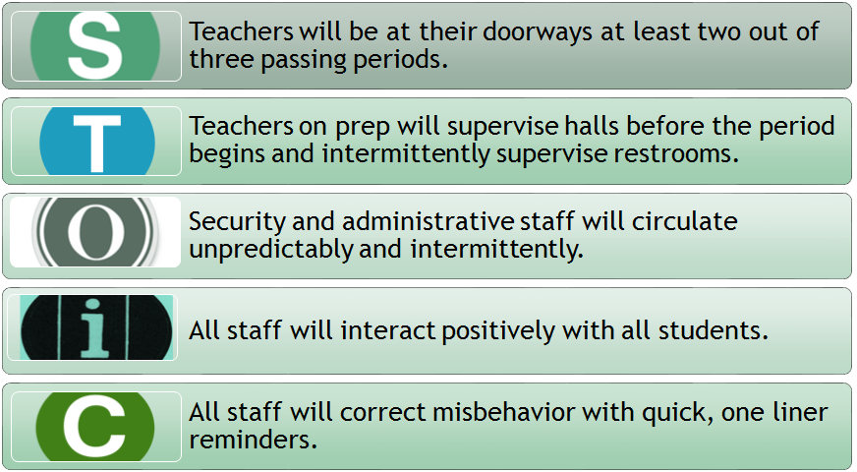
STAFF EXPECTATIONS

Slide 32
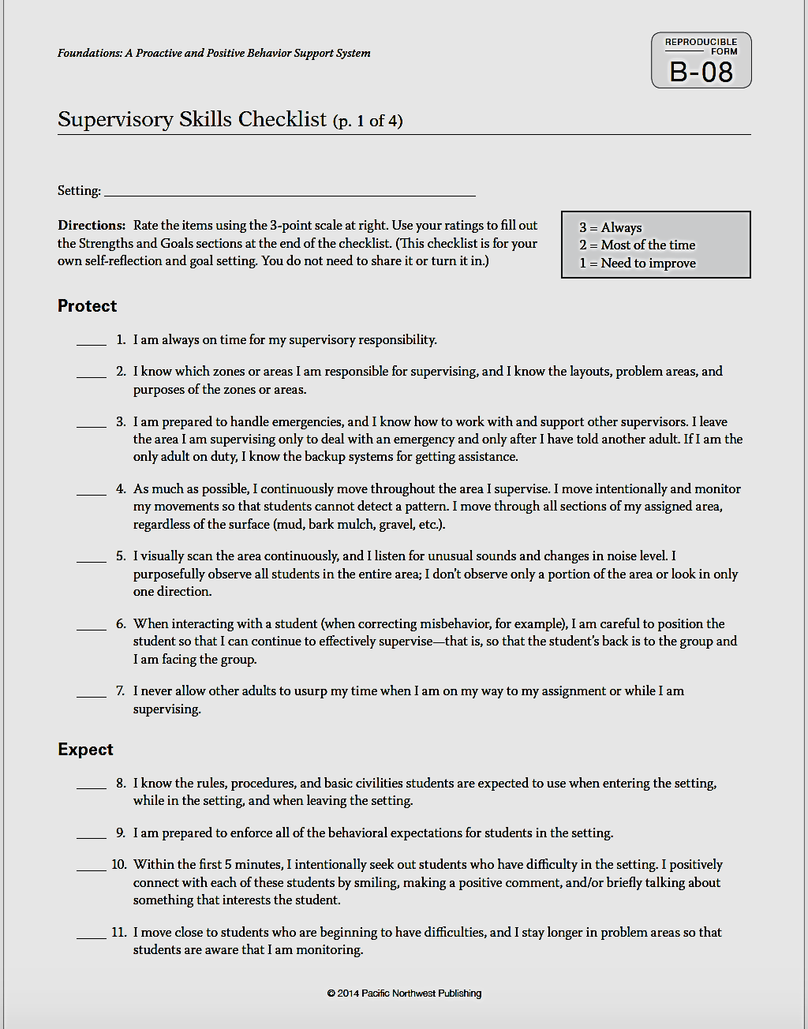
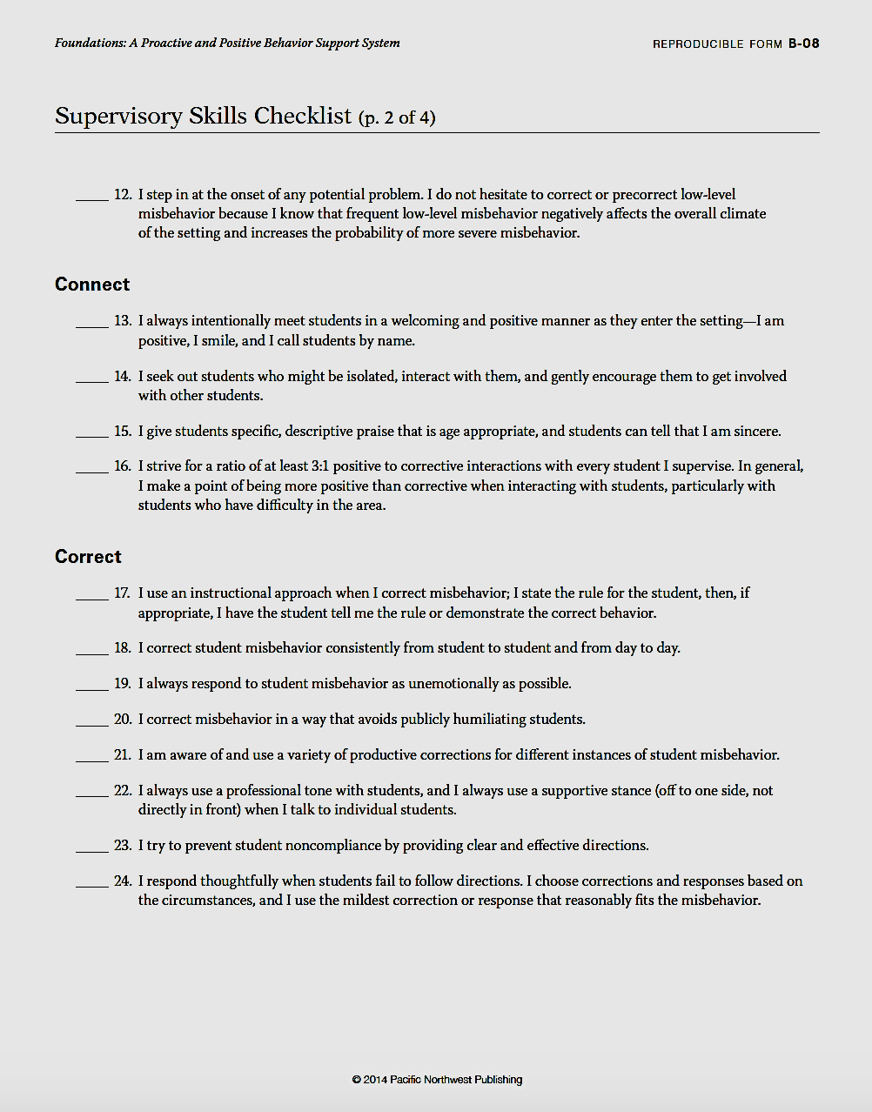
Notes:
fill out to rate your campus on their supervisory skills as a whole. Focus on Expect and Correct….and at your own team meeting you can look at and assess the other categories.

Slide 33
LET’S PLAN AHEAD

Slide 34
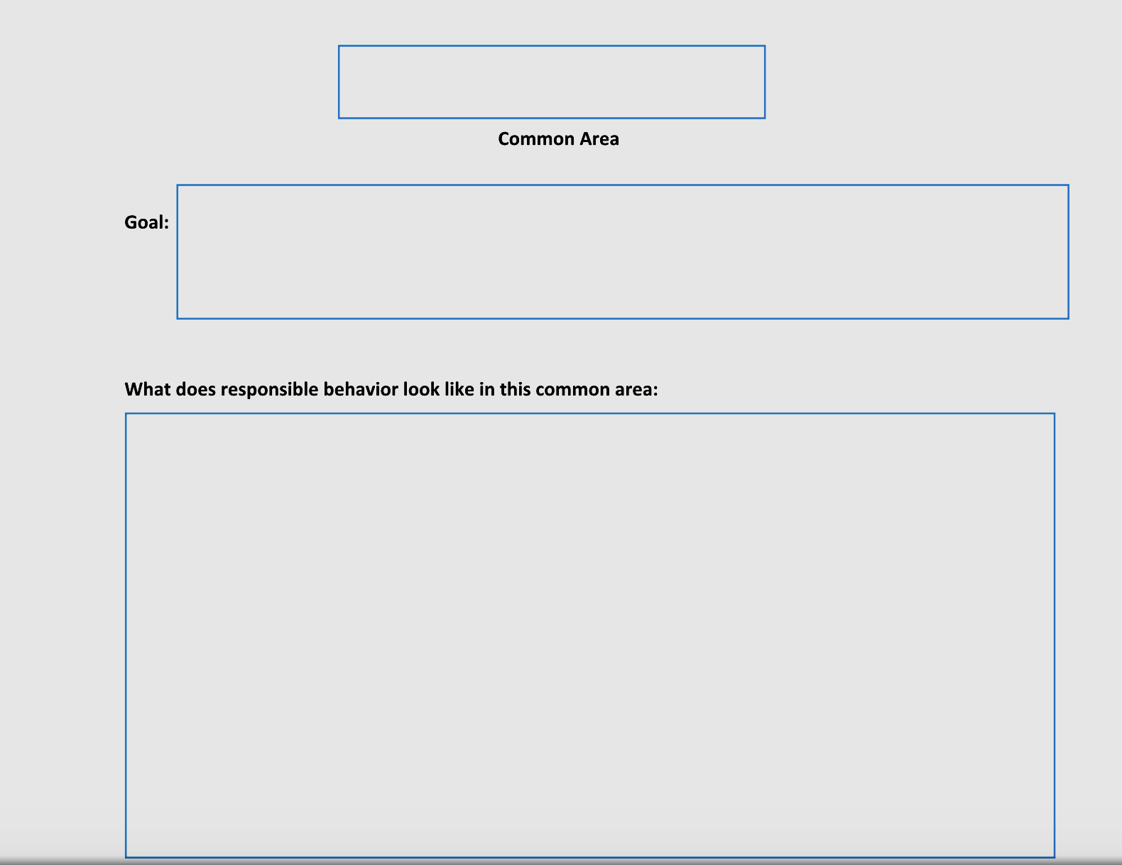
Lesson Planning

Slide 35
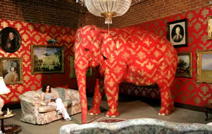

Slide 36
Foundations Showcase
You will be back in April; you will showcase your Foundations plan for your common area.
You will also be given time to start planning for other common areas.

Slide 37
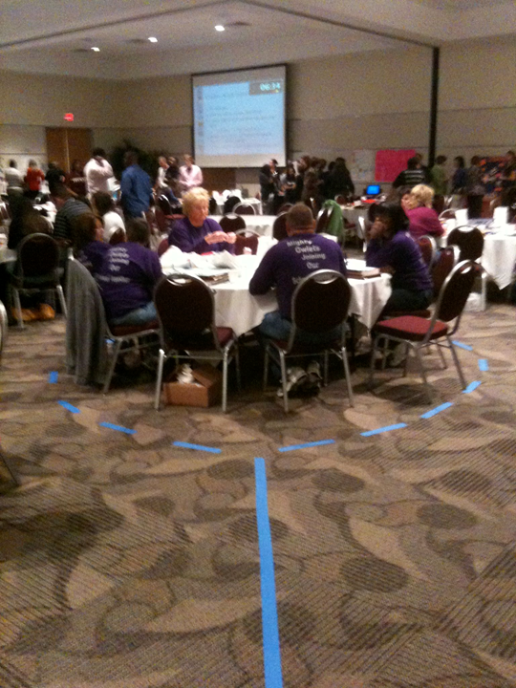

Slide 38
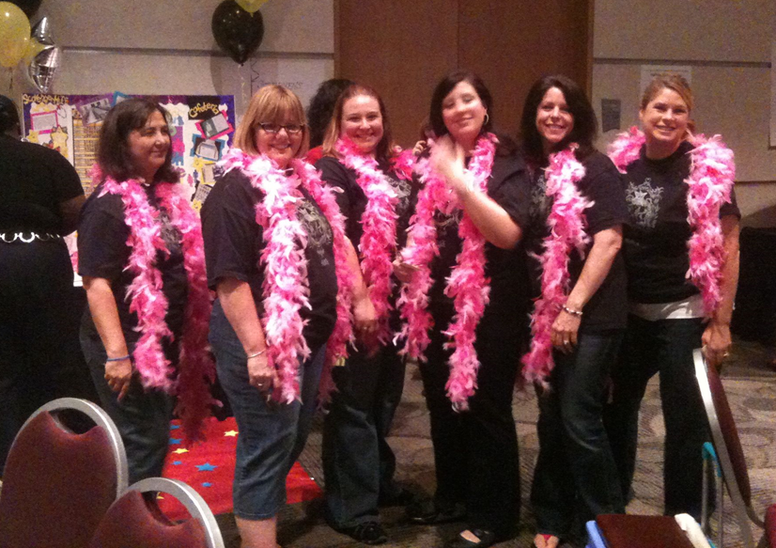

Slide 39
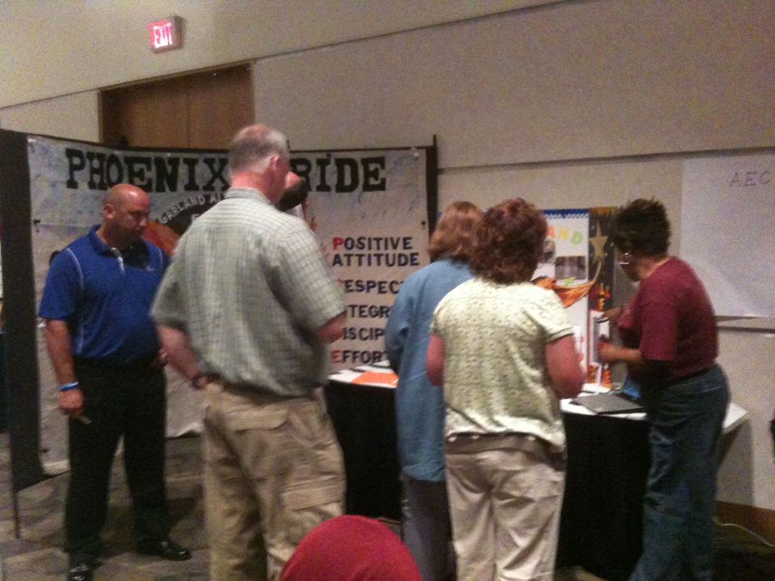

Slide 40
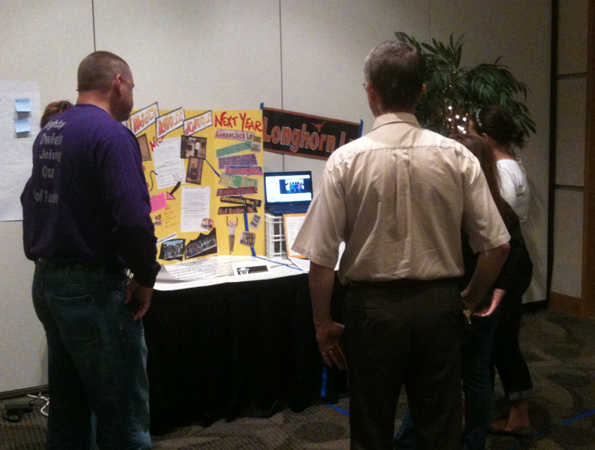

Slide 41
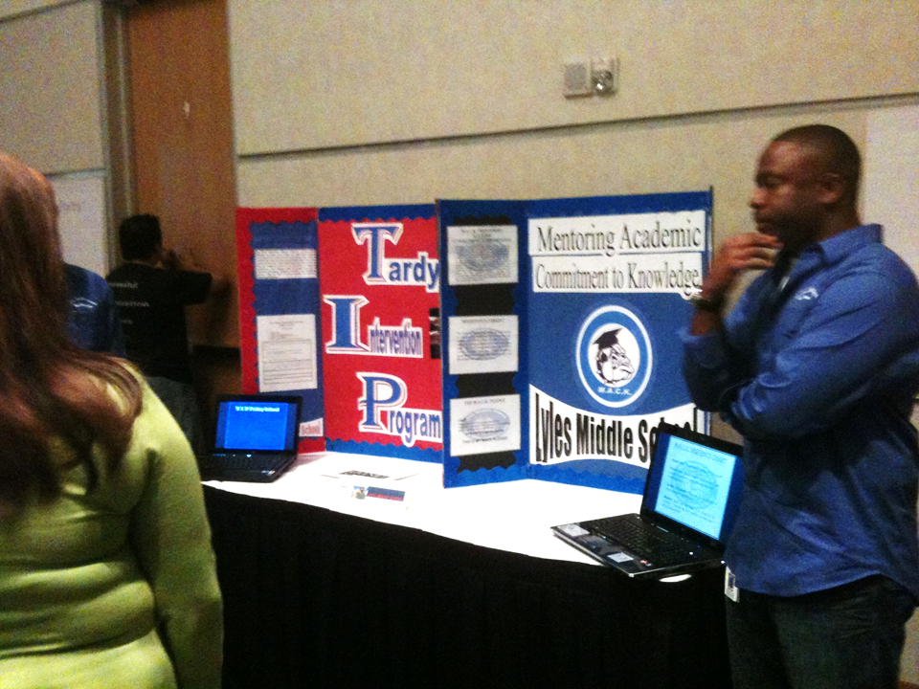

Slide 42
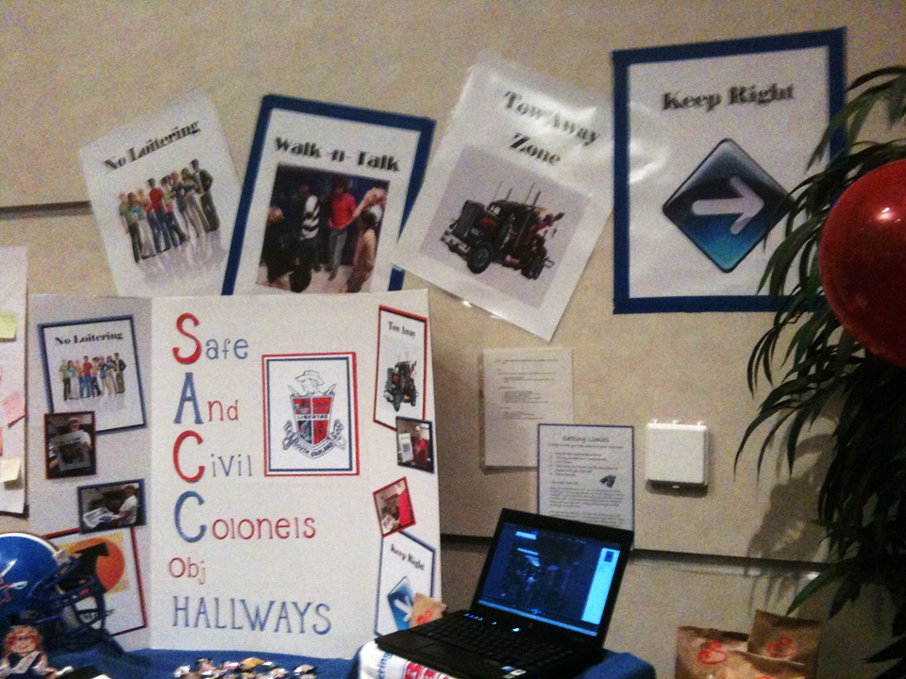

Slide 43
Work Time
This time is built in for you to work on making sure that you have the checklist items ready for the showcase.
When the timer goes off we will review again what you need to have with you for next time.

Slide 44
Your HOMEWORK!

Slide 45
