Slide 1
Behavior Summit: Creating Positive Behavior Interventions & Supports

Slide 2
https://youtu.be/qy_mIEnnlF4

Slide 3
CONSEQUENCE
BEHAVIOR
DISCIPLINE
PUNISHMENT

Slide 4
CONSEQUENCE
- something produced by a cause or necessarily following from a set of conditions
- importance with respect to power to produce an effect
BEHAVIOR
- the manner of conducting oneself
- the response of an individual, group, or species to its environment
DISCIPLINE
- training that corrects, molds, or perfects the mental faculties or moral character
- control gained by enforcing obedience or order
- self-control
- a rule or system of rules governing conduct or activity
PUNISHMENT
- suffering, pain, or loss that serves as retribution

Slide 5
School-Wide Perspective
Students & staff members will be physically and emotionally safe.

Slide 6
School-Wide Perspective
Students & staff members will be physically and emotionally safe.
The school environment will be welcoming and inviting to all students.

Slide 7
School-Wide Perspective
Students & staff members will be physically and emotionally safe.
The school environment will be welcoming and inviting to all students.
Students are explicitly taught the behavioral skills they need.

Slide 8
School-Wide Perspective
Students & staff members will be physically and emotionally safe.
The school environment will be welcoming and inviting to all students.
Students are explicitly taught the behavioral skills they need.
Staff members feel empowered to manage student behavior.

Slide 9
School-Wide Perspective
Students & staff members will be physically and emotionally safe.
The school environment will be welcoming and inviting to all students.
Students are explicitly taught the behavioral skills they need.
Staff members feel empowered to manage student behavior.
Everyone on campus feels motivated and is engaged in meaningful learning tasks, that directly impact student success.

Slide 10
Historical Perspective
Behavior management has typically consisted of trying to “make” students behave.
Leads to an over-dependence on reactive procedures
Make us hold onto “simple solutions”
An increase in emotional intensity
An overdependence on role-bound authority
An overdependence on punishment

Slide 11
Flexible Process
Research indicates that this process
should rely on four aspects:
Data-driven decisions
Direction by a representative, site-based team
Involve the entire staff
Ongoing improvement cycle

Slide 12
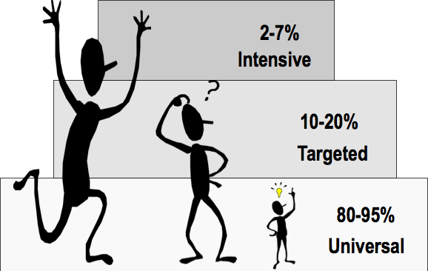
Understanding Our Students

Slide 13
Intensive Intervention
Tier 3
1-5%
Targeted
Intervention
Tier 2
10-15%
Universal Instruction
including differentiation and remediation
Tier 1 80-90%
Academic
Behavior

Slide 15
What behaviors are prevalent?
= 10 points
= 5 points
=1 point

Slide 16
3 year plan

Slide 17
3 year plan

Slide 18
3 year plan

Slide 19
Self-evaluate
Campus Committee attends training
Campus Committee trains campus
Campus Committee works through the activities to create individual Campus Plan
Collect Data

Slide 21
Self-evaluate
Campus Committee attends training
Campus Committee trains campus
Campus Committee works through the activities to create individual Campus Plan
Collect Data

Slide 22
Self-evaluate
Campus Committee attends training
Campus Committee trains campus
Campus Committee works through the activities to create individual Campus Plan
Collect Data

Slide 23
Campus Behavior Committee
Administrator (1)
Campus Principal (non-negotiable)
Assistant Principal (optional)
Department / Grade Level Chair
Other Staff (1-2)
Academic Dean
General Education
Other Leadership Positions (1)
Special Education (1 only)
Core Content teachers (3-6)
Counselor
Family Specialist
Elective Teacher (ie: PE, Art, Music etc)
Instructional Coach
Paraprofessional*

Slide 24
Self-evaluate
Campus Committee attends training
Campus Committee trains campus
Campus Committee works through the activities to create individual Campus Plan
Collect Data

Slide 25
Self-evaluate
Campus Committee attends training
Campus Committee trains campus
Campus Committee works through the activities to create individual Campus Plan
Collect Data

Slide 26
Self-evaluate
Campus Committee attends training
Campus Committee trains campus
Campus Committee works through the activities to create individual Campus Plan
Collect Data

Slide 27
Foundations
Year 1:
Module A: Foundations of Behavior Support—A Continuous Improvement Process
Module B: Managing Behavior in Common Areas and With School wide Policies

Slide 28
Foundations
Year 1:
Module A: Foundations of Behavior Support—A Continuous Improvement Process
Module B: Managing Behavior in Common Areas and With Schoolwide Policies
Year 2:
Module C: Conscious Construction of an Inviting School Climate
Module D: Responding to Misbehavior—An Instructional Approach
Module E: Improving Safety, Managing Conflict, and Reducing Bullying

Slide 29
Foundations
Year 1:
Module A: Foundations of Behavior Support—A Continuous Improvement Process
Module B: Managing Behavior in Common Areas and With Schoolwide Policies
Year 2:
Module C: Conscious Construction of an Inviting School Climate
Module D: Responding to Misbehavior—An Instructional Approach
Module E: Improving Safety, Managing Conflict, and Reducing Bullying
Year 3:
Module F: Establishing and Sustaining a Continuum of Behavior Support

Slide 30
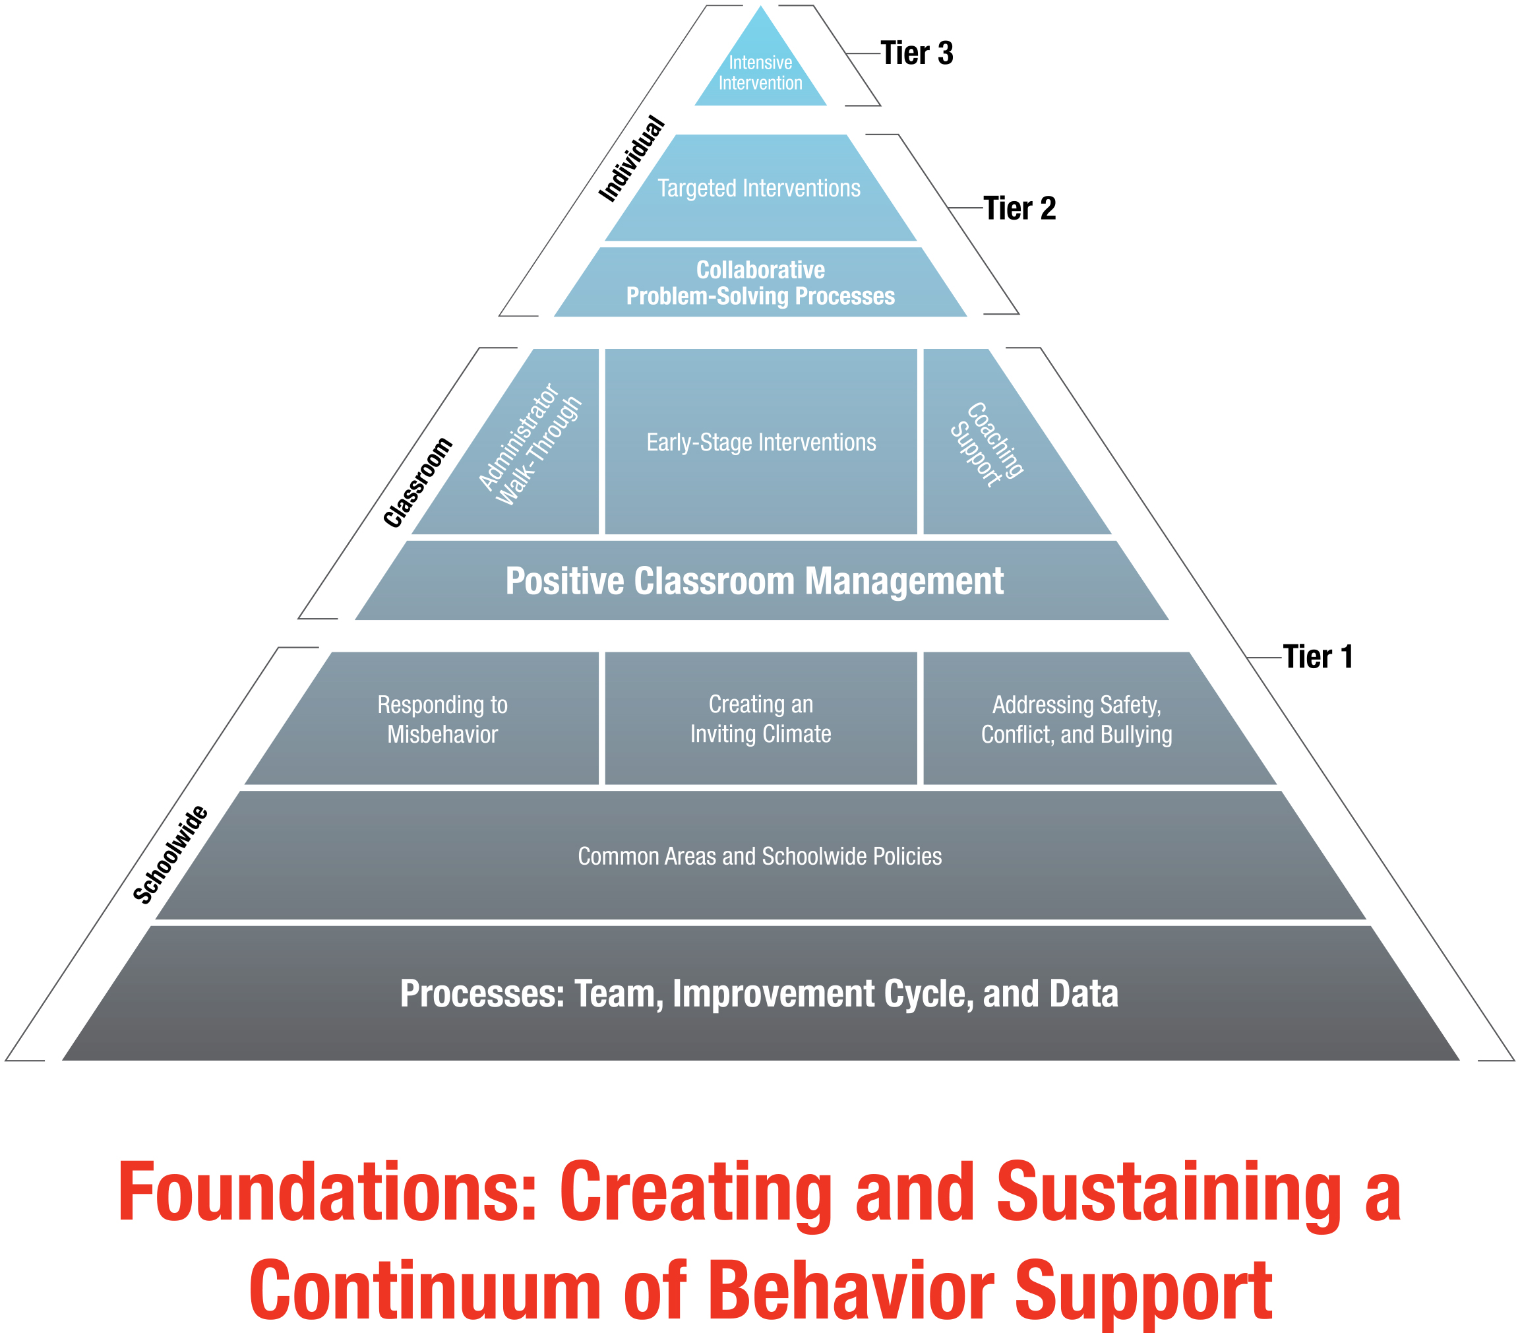

Slide 31
Foundations
How is it structured?
What resources are available?
Locate the rubric & implementation checklist

Slide 33
Solution oriented

